Slide 1

Information and Network Security(INS)

Slide 2
INS - Lecture 3 Presented by: Drashti Shrimal

Slide 3
UNIT 1: Topics in this presentation
OSI architecture - Detailed(Part 1)
- Security Attacks
- Types of attacks

Slide 4
OSI architecture : Security Attacks
Attack is an assault on system security that derives from an intelligent threat; that is, an intelligent act that is a deliberate attempt (especially in the sense of a method or technique) to evade security services and violate the security policy of a system.
There are two types of attacks:
- Passive
- Active

Slide 5
Security Attacks: Passive attacks
A passive attack is a network attack in which a system is monitored and sometimes scanned for open ports and vulnerabilities. The purpose is solely to gain information about the target and no data is changed on the target.
There are two types:
1. Release of message contents:
A telephone conversation, an electronic mail message, and a transferred file may contain sensitive or confidential information. We would like to prevent an opponent from learning the contents of these transmissions.

Slide 6
Security Attacks: Passive attacks
2. Traffic analysis:
Suppose that we had a way of masking the contents of messages or other information traffic so that opponents, even if they captured the message, could not extract the information from the message. The common technique for masking contents is encryption.
If we had encryption protection in place, an opponent might still be able to observe the pattern of these messages. The opponent could determine the location and identity of communicating hosts and could observe the frequency and length of messages being exchanged. This information might be useful in guessing the nature of the communication that was taking place.

Slide 7
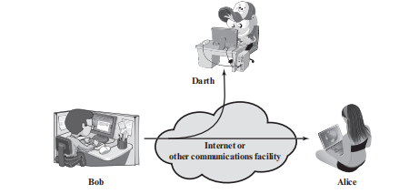
Passive attacks: Overview

Slide 8
Security Attacks : Active attacks
Active attacks involve some modification of the data stream or the creation of a false stream and can be subdivided into four categories:
masquerade,
replay,
modification of messages
denial of service.

Slide 9
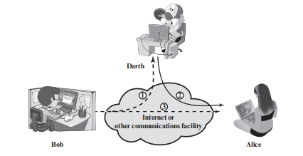
Active attacks: Overview

Slide 10
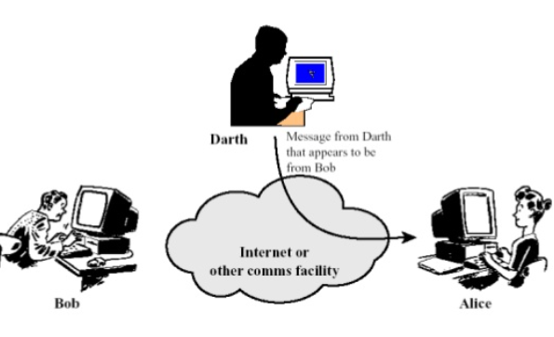
Types of Active attacks
1. Masquerade attack: When someone pretends as someone else to gain information.

Slide 11
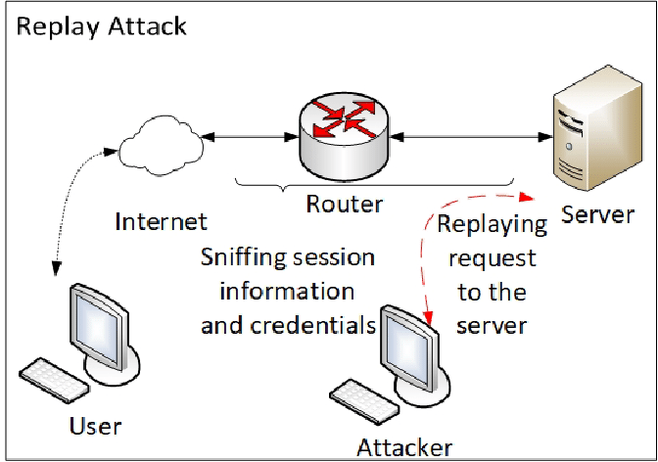
Types of Active attacks
2. Replay attack: A replay attack (also known as playback attack) is a form of network attack in which a valid data transmission is maliciously or fraudulently repeated or delayed.

Slide 12
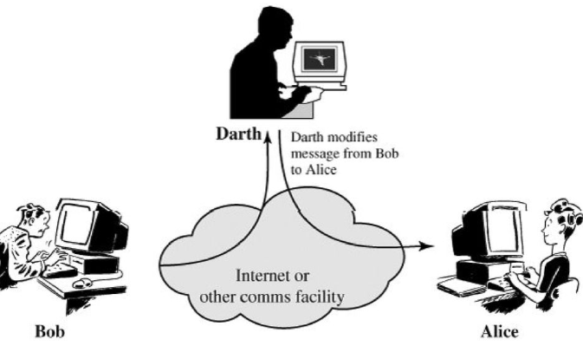
Types of Active attacks
3. Modification of Messages: The intruder sits in between the sender and receiver, alters the message transmission between them and sends further. Its also called as man-in-the-middle attack.

Slide 13
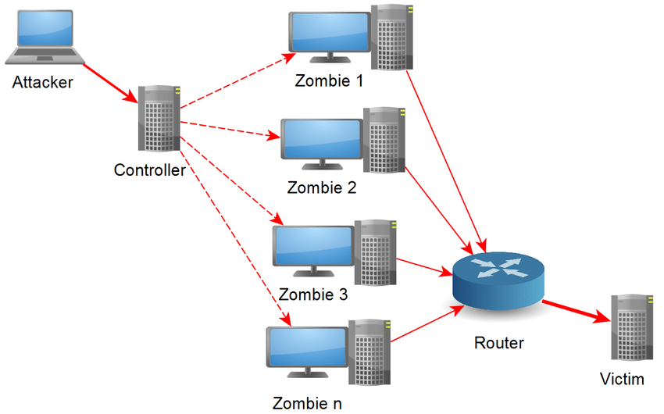
Types of Active attacks
4. Denial of service attacks: #TheYahooExample

Slide 14
Thanks!
Any questions?

